Slide 1


Write-Info
“About Me”

Slide 2





Former Student
Senior Automation Consultant
PowerShell (2013)
Play Paintball and Running.
PowerShellMichael \ PowerShellLive \ BrisPug
@PowerShellMich1
https://au.linkedin.com/in/michael-zanatta-61670258
https://www.youtube.com/channel/UCQfLvFYohCCm_gTPEUfaAbw
Notes:
Former Student at SBIT (Class of 2008)
Senior Automation Consultant at Insync Technology/ PowerShell SME/ Advocate/ Speaker/ Author & Meetup Organizer
Stream PowerShell Projects. Channels on Twitch.Tv/ Youtube
MSDOS 4.2 (2004), VBSCRIPT (2005), POWERSHELL (2013)
Play Paintball and Running. Trained in CQB
Brisbane PowerShell User Group

Slide 3

Congratulations!
@PowerShellMich1
Notes:
Congratulations Guys, this might be the best decision of your life to choose IT.
Right now you are being handed a golden apple.
Why do I say that? IT pays really well.
However it’s up to you to do something with that.

Slide 4
This is an
AMA Session
Notes:
Guys this is an AMA session. Ask me anything about IT. To help you get the juices flowing:

Slide 5
“What was the worst
Day ever in IT?”

Slide 6
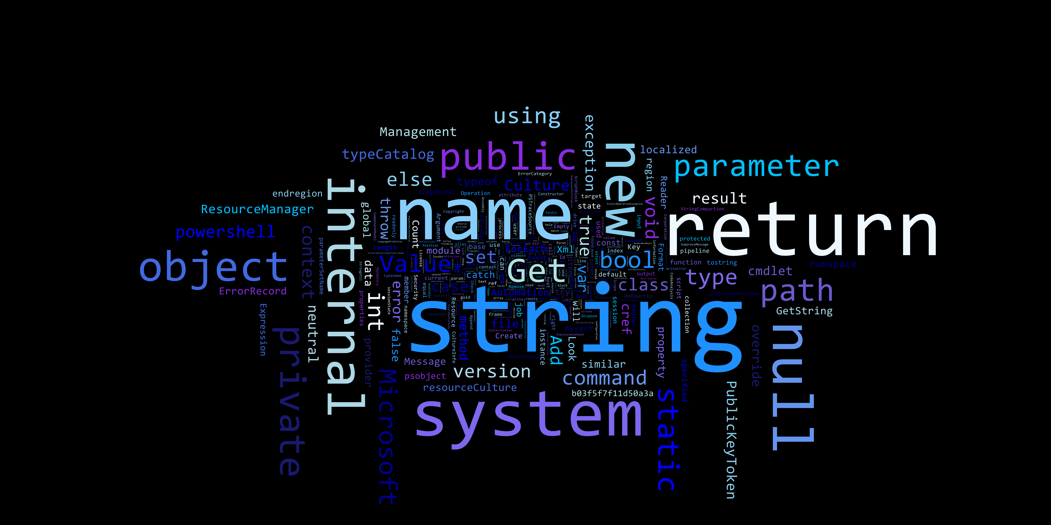

WHAT is PowerShell?
Notes:
So what is PowerShell?
Is it a Scripting Language?

Slide 7
PowerShell is an Automation/ Configuration Framework
PowerShell Scripting Engine
Desired State Configuration (IaC)
@PowerShellMich1
Notes:
PowerShell is an Automation Configuration Framework.
PowerShell is built on the .NET framework and C#, which makes it language variant of C#.
However PowerShell offer’s more then just C#. It can run J#, VB.NET & with other modules C++ making it extremely versicle.
I heard one person tell me that PowerShell is the Glue that holds Microsoft Product Together. While not literal, PowerShell plays a key role in Microsoft Technologies
It consists of two main components:
PowerShell Scripting Engine. Object Orientated.
Desired State Configuration. Defines how a software environment should be configured.
No Desired State Configuration in this lesson.
PowerShell Scripting Engine
PowerShell Offers Unit Based Testing
Administrative management of All Windows Applications (Active Directory, Exchange, HyperV, Clustering, System Centre Suite)
It can interact with Web API’s (SOAP and REST)
It can do anything!

Slide 8
WHAT can
PowerShell Do?

Slide 9
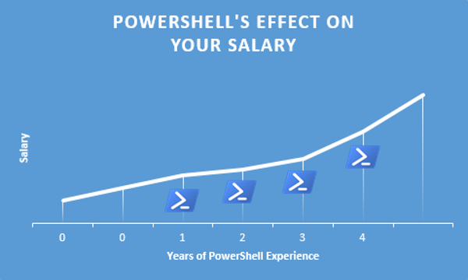
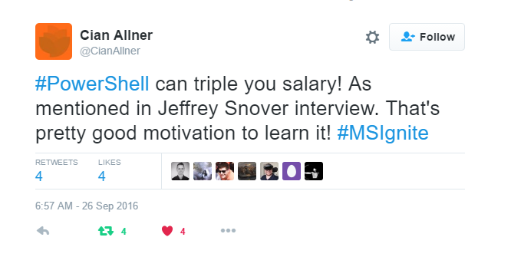
Increase your Salary
Notes:
Josh Duffney wrote an article called: “Doubling My Salary a PowerShell Story”
He talked about the financial benefits of learning PowerShell.
Sources: http://duffney.io/doubling-my-salary-a-powershell-story

Slide 10
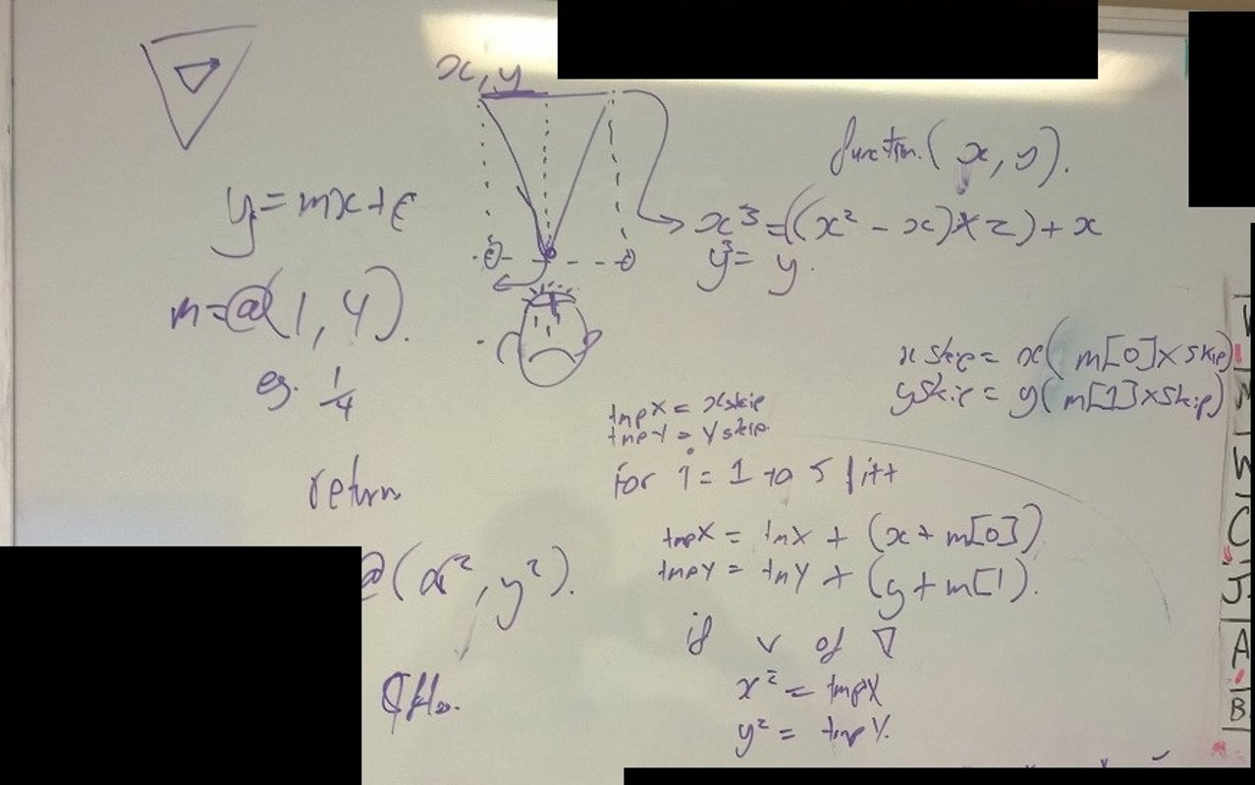
Battlefield 4 Pixel Aimbot

Slide 11
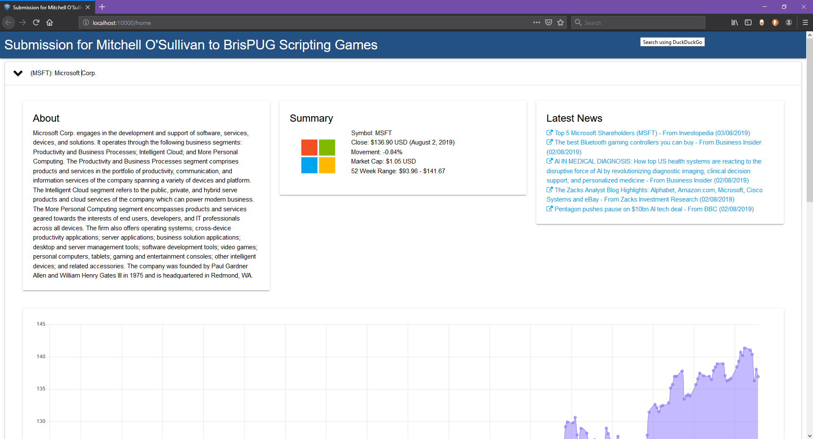
PowerShell Universal Dashboard

Slide 12
The PowerShell
“Cmdlet” Explained
Notes:
A PowerShell cmdlet is a lightweight command that is used in the Windows PowerShell environment.
Windows PowerShell uses a verb-and-noun name pair to name cmdlets
They are not stand-alone executables. Cmdlets are instances of objects . i.e Ping, Net, Tracert
Cmdlets can be created from as few as a dozen lines of code.
Cmdlets do not generally do their own parsing, error presentation, or output formatting. Parsing, error presentation, and output formatting are handled by the Windows PowerShell.
Source: https://docs.microsoft.com/en-us/powershell/developer/cmdlet/cmdlet-overview

Slide 13
The Verb-Noun Naming Standard
Was developed to make it easier to understand that intention of the cmdlet
Verb Prefix describes the action
Noun Suffix describes the resource
@PowerShellMich1
Notes:
Sources: https://docs.microsoft.com/en-us/powershell/developer/cmdlet/cmdlet-overview
Sources: https://docs.microsoft.com/en-us/powershell/developer/cmdlet/approved-verbs-for-windows-powershell-commands

Slide 14
Rename-Computer
Add-WindowsFeature
New-NetIPAddress
Set-DNSClientServerAddress
Restart-Computer
Install-ADDSForest
Set-DNSServerForwarder
@PowerShellMich1

Slide 15
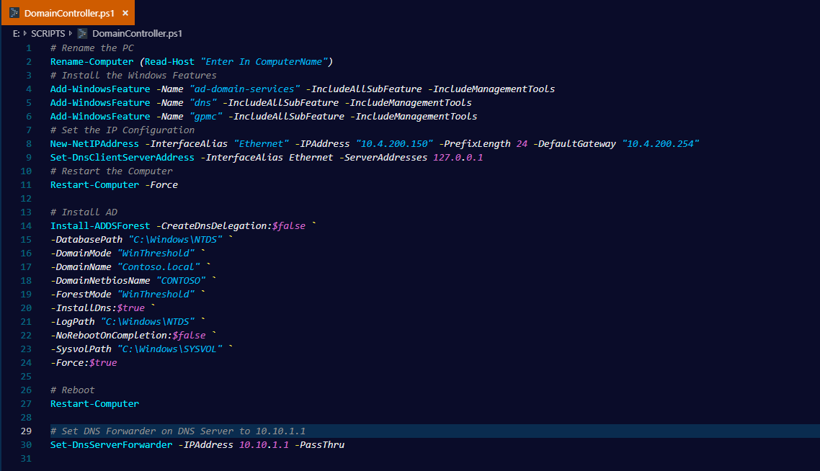

Slide 16
Parameters
Parameters define the input of the Cmdlet. (Pass Arguments to the Script)
@PowerShellMich1
Notes:
Parameters define the input of the cmdlet. (Pass Arguments to the Script)
Example:
DVD Player. The parameters are the button on the DVD player.
Sources: https://docs.microsoft.com/en-us/powershell/developer/cmdlet/cmdlet-overview
Sources: https://docs.microsoft.com/en-us/powershell/developer/cmdlet/approved-verbs-for-windows-powershell-commands

Slide 17
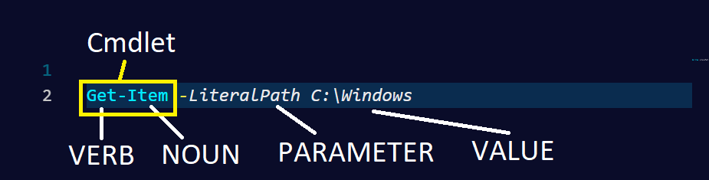
Notes:
Ask the students:
How would I change the value to look at the program files?

Slide 18
Important Commands to know
Get-Command -> Gets All Commands
Get-Help -> Get’s the Help for a Command
Get-Member -> Get’s the Members, Properties, Methods of Objects
@PowerShellMich1
Notes:
https://docs.microsoft.com/en-us/powershell/module/microsoft.powershell.core/get-help?view=powershell-6
https://docs.microsoft.com/en-us/powershell/module/microsoft.powershell.core/get-command?view=powershell-6
https://docs.microsoft.com/en-us/powershell/module/microsoft.powershell.utility/get-member?view=powershell-6

Slide 19
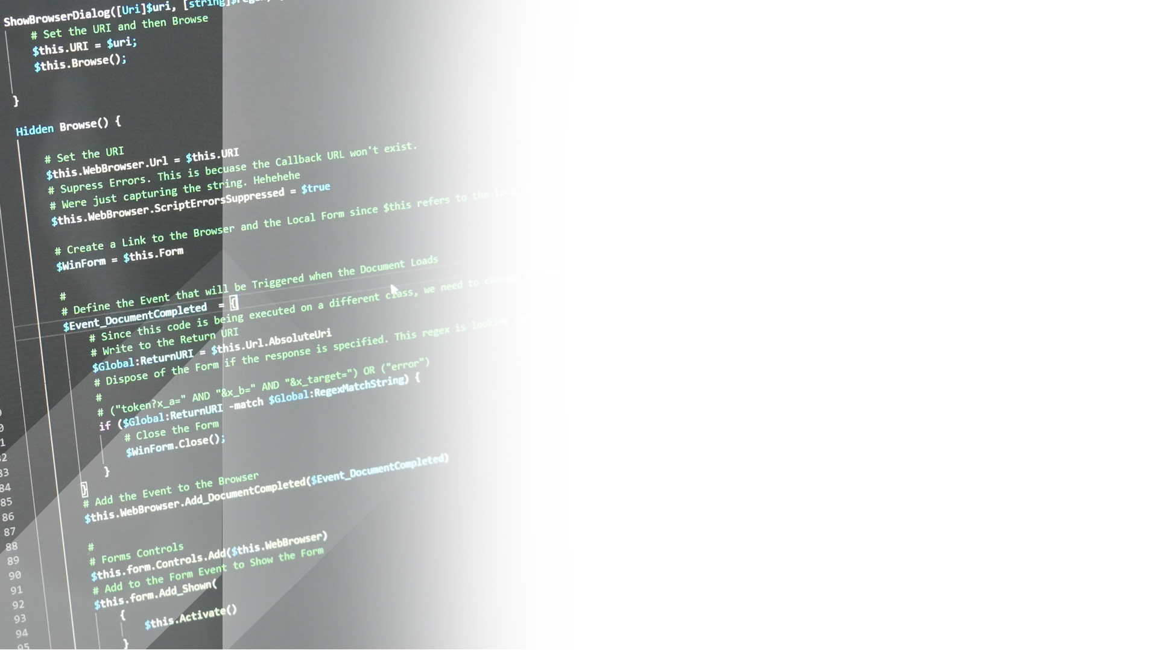
Demo Time!
Notes:
In this demo we are going to:
Lets’ set them up:
Show people on how to setup PowerShell ISE
Bypass script execution
Test changes
Explore the Verb-Noun Format
Get-Process (Ask the class)
Get-ChildItem
Explore Get-Command and Get-Help
Get-Help -Name Get-Process
Get-Help -Name Get-ChildItem
Explore Parameters
Get-Help -Name Get-Process -Full
Get-Help –Name Get-ChildItem –Full
Get-Process –Name
Get-ChildItem –LiteralPath -File
Explore Alias
Use Get-Alias to get Get-Process

Slide 20
The PowerShell
“Pipeline” Explained
Notes:
The PowerShell Pipeline!

Slide 21
Pipelines
Act like connected segments of pipe
Using Pipeline Operator “|”
Reduce Effort
Passes Objects not Text
@PowerShellMich1
Notes:
The PowerShell Pipeline allows you to send the output (not text) from one command into the input for another command using the operator “|”.
This was implemented to reduce effort of using complex commands and make it easier to see the flow of commands.
What’s different between command prompt “|” operator? PowerShell Passes Object’s not just text.
For example:
Getting the Actual Object (Filename, Size, Length) vs Filename
https://docs.microsoft.com/en-us/powershell/scripting/learn/understanding-the-powershell-pipeline?view=powershell-6

Slide 22
New-TemporaryFile | Set-Content
Get-ADUser | Disable-ADUser
Get-ChildItem | Remove-Item
@PowerShellMich1

Slide 23
Demo Time!
Notes:
In this demo we are going to explore the PowerShell Pipeline:
Everyone can follow along with this:
# Create a Directory D:\DEMO
New-Item -Path "D:\DEMO" -ItemType Directory
# Get the Current Date and export it to Demo02.txt
Get-Date | Set-Content -LiteralPath "D:\DEMO\Demo02.txt“
# Using Get-Process let’s open Mspaint
* Ask for Volunteer
Start-Process -FilePath mspaint
Get-Process -Name mspaint
Get-Process -Name mspaint | Stop-Process
#
# Let’s do this with active directory
Get-ADUser | Set-ADUser

Slide 24
Do’s and Dont’s
Use Full Cmdlet
Use Full Parameters
Use –WhatIf
Don’t understand? Don’t run!
@PowerShellMich1
Notes:
PowerShell Do’s and Dont’s
When writing Scripts: Use the full Cmdlet and Parameter Names
When using High Risk Cmdlets. If the cmdlet support’s it: Use the –WhatIf Parameter. Use AD
Document your Code! Documenting your code and your intentions is key for another person to understand.
Space your Code! Readability of code is really important.
Don’t run code you don’t understand. This year I had a person come up to me at a Microsoft conference and told me that people like me will be out of a job, because all he had to do was copy and paste code from the internet.
Every environment is different and you might be introducing a fatal bug in your code.

Slide 25
Demo Time!
Notes:
In this demo we are going to:
Explore the PowerShell ISE
Setting Script Execution
Create a PowerShell File .ps1
Let’s write a script:
Let’s Create a New Virtual Machine
All Students Write their Very First PowerShell Script (Optional)
Open PowerShell as administrator
Set-ExecutionPolicy -ExecutionPolicy Unrestricted
Write-Host “Hello World!”
6. Let’s write a cool script:
0> Browse to: https://github.com/ZanattaMichael/Brispug
Get Students to browse to it:
Browse to
1> Download a userlist from the internet
2> Let’s create those users in Active Directory

Slide 26
Let’s Add Some Users!
Google: “ZanattaMichael Github”
Select “BrisPug”
@PowerShellMich1

Slide 27
Pablo Calaby
Hudson Recruitment
Level 17, Central Plaza II
66 Eagle Street
Brisbane, 4000 Australia
t: 07 3258 8327
pablo.calaby@hudson.com
@PowerShellMich1
Notes:
IT Recruitment:
Pablo Calaby
Senior ICT Consultant, Infrastructure
Level 17, Central Plaza II
66 Eagle Street
Brisbane, 4000 Australia
t: 07 3258 8327
m: 0402 456 588
pablo.calaby@hudson.com

Slide 28
Mentorship
Program
Notes:
Kick off a new mentorship program:
Give your time and I will mentor you into being fluent with being PowerShell.
100% free not strings attached.

Slide 29
Thankyou!
Google: “ZanattaMichael Github”
Select “BrisPug”
@PowerShellMich1

